Slide 1
KWAME NKRUMAH UNIVERSITY OF SCIENCE AND TECHNOLOGY COLLEGE OF ENGINEERING DEPARTMENT OF ELECTRICAL/ELECTRONIC ENGINEERING
CENG 291: ENGINEERING IN SOCIETY
BY
DR. DANIEL OPOKU

Slide 2
Introduction-commitment to safety
We demand safe products and services because we do not wish to be threatened by potential harm , but we also realize that we may have to pay for this safety. What may be safe enough for one person may not be for someone else.
Absolute safety in the senses of entirely risk-free activities and products, or a degree of safety that satisfies all individuals or groups under all conditions is neither attainable nor affordable.

Slide 3
The concept of safety
According to William W. Lowrance: “a thing is said to be safe if its risks are judged to be acceptable.”
However this definition was modified because it departs far too much from our understanding of safety.
Modified definition: a thing is safe if, were its risks fully known, those risks would be judged acceptable by a reasonable person in light of their settled value principles.
Safety is thus a matter of how people would find risks acceptable or unacceptable if they knew the risks and basing their judgements on their most settled value perspectives.

Slide 4
RISK
A risk is the potential that something unwanted and harmful may occur. According to William D. Rowe, it is the “ potential for the realization of unwanted consequences from impending events.”
Risk like harm is a broad concept covering many different types of unwanted occurrences.
Good engineering practices has always been concerned with safety but as technology’s influence on society has grown, so has public concern about technological risks increased.

Slide 5
Acceptability of Risk
A risk is acceptable when those affected are no longer (or not) apprehensive about it. Apprehensiveness depends to a large extent on how risk is perceived. This is influenced by such factors as;
Whether the risk is accepted voluntarily
The effects of knowledge on how the probabilities of harm (or benefit) are known or perceived
If the risks are job-related or other pressures exists that cause people to be aware of or to overlook risks
Whether the effects of s risky activity or situation are immediately noticeable or are close at hand
Whether the potential victims are identifiable beforehand.

Slide 6
Assessing and reducing risk
Any improvement in safety as it relates to an engineered product is often accompanied by an increase in the cost of that product. Products that are not safe incur secondary costs to the manufacturer beyond the primary (production) costs that must also be taken into account.
It is therefore important for manufacturers and users alike to reach some understanding of the risks connected with any given product and know what it might cost to reduce those risks.

Slide 7
Uncertainties in Design
Risk is seldom designed into a product. It arises because of the many uncertainties faced by the design engineer, the manufacturing engineer, and even the sales and applications engineer.
This maybe due to:
There are some industries where information is not freely shared; for instance when the cost of failure is less than the cost of fixing the problem.
Problems and their causes are often not revealed after a legal settlement has been reached with a condition of non-disclosure.
There are always new applications of old technology, or substitutions of materials and components, that render the available information less useful.

Slide 8
Capability Curve
For a given point on a capability curve, the value along the vertical axis gives the probability that the capability, or strength, is equal to the corresponding value along the horizontal axis.
Associated with capability and duty curves are nominal or, statistically speaking, expected values c and d. C/D is the “safety factor” and is based on our consciousness.
If the respective values of D and C remain the same, then so does the safety factor c/d.

Slide 9
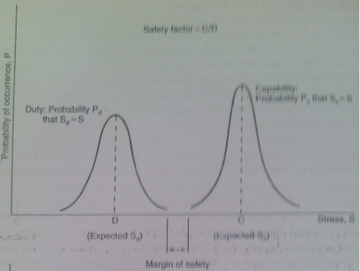
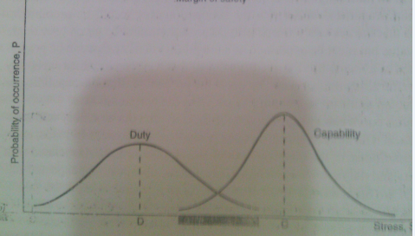
Cont’d Capability Curve

Slide 10
Risk benefit analyses
Many large projects, especially public works are justified on the basis of a risk-benefit analysis. The questions answered by such a study are the following:
Is the product worth the risks connected with its use
What are the benefits
Do they outweigh the risks
A closer examination of risk benefit analyses reveals some conceptual difficulties. Both risks and benefits lie in the future since there is some uncertainty associated with them
However, risk benefit analysis like cost-benefit analysis is concerned with the advisability of undertaking a project.

Slide 11
Personal risk
An individual can decide whether to participate in a risky activity given sufficient information. Chauncey Starr asserted that individuals are more ready to assume voluntary risks than involuntary risks or activities over which they have no control.
The difficulty in assessing personal risks is magnified when we consider involuntary risks.
The result of these difficulties in assessing personal risk is that analysts employ whatever quantitative measures are ready at hand.

Slide 12
Public risk and public acceptance
Risks and benefits to the public are more easily determined because individual differences tend to even out as larger numbers of people are considered.
Assessment studies relating to technological safety can be conducted more readily in the detached manner of a macroscopic view as statistical parameters take on greater significance as this is a more convenient measure than sorting out the latest figures from court cases.

